Slide 1

Code for Pie Chart

Slide 2
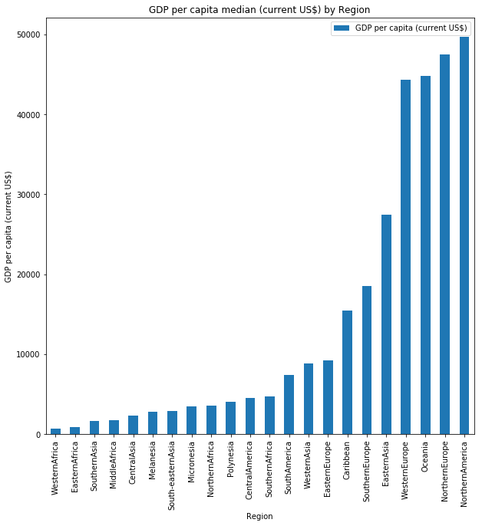
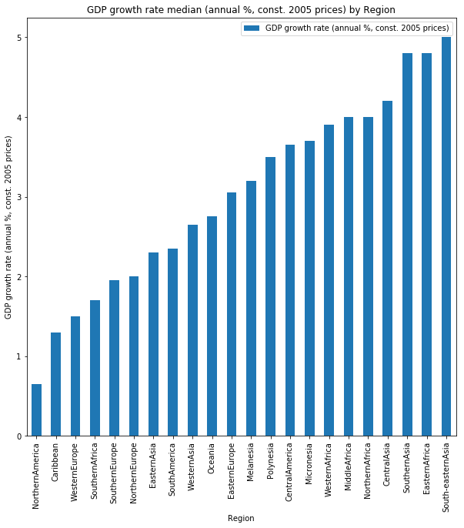
Northern America, Northern Europe, Oceania and Western Europe, have the highest median GDP per capita
Asian and African regions have the highest median GDP growth rates

Slide 3
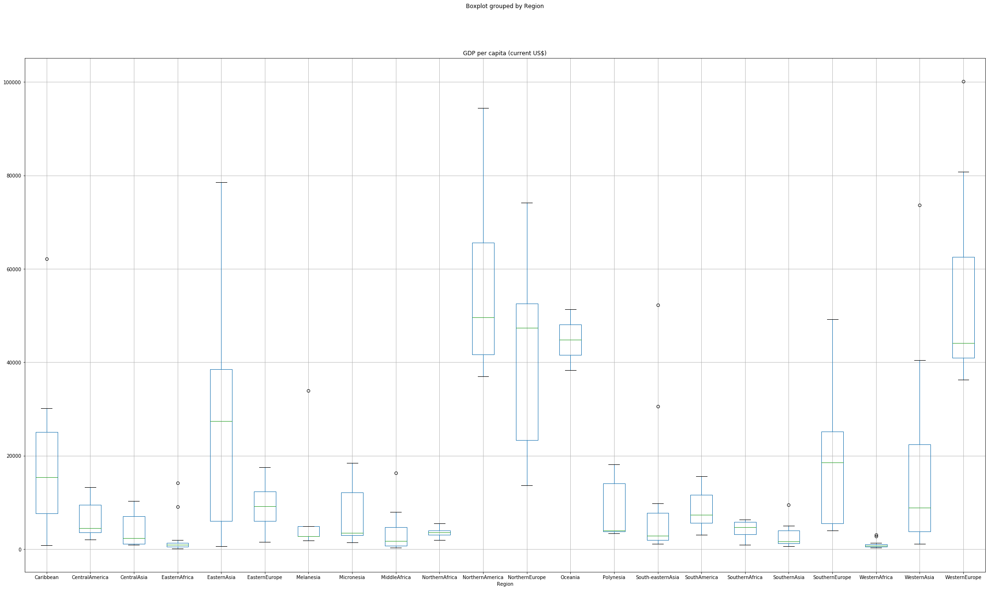
GDP per capita boxplot of regions

Slide 4

With the exception of Oceania, regions that have the highest median GDP also have the widest distribution in GDP values
Based on the p value of the top GDP/capita regions, we are unable to reject the null hypothesis, and therefore the differences between the top regions may not be statistically significant

Slide 5
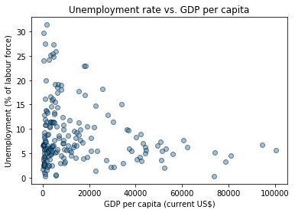
How does GDP per capita affect the Unemployment rate?
Unemployment rate is less than 10%, when GDP per capita is 40,000 US$ or more
However regions with lower GDP per capita, may still also have a low unemployment rate

Slide 6
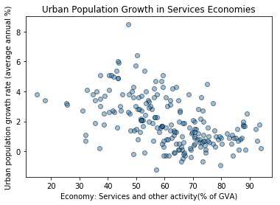
Higher services based economies, have lower urban population growth

Slide 7
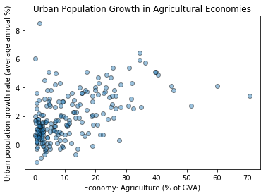
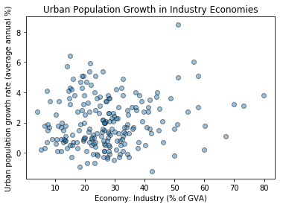
More industrial and agricultural based economies do not necessarily have higher urban growth rates

Slide 8

Life Expectancy
Is there a correlation between the percentage of a country’s GDP spent on healthcare and life expectancy for men and women?
It appears that for the countries that spend approximately 4% to 8% of their GDP on healthcare most men and women lived to be about 75 to 80 years old. However, the countries that spent 10% to 12% saw the greatest life expectancy at 85 years. Only a couple countries such as the United States spend about 16% of their GDP on healthcare and only gain a marginal improvement in life expectancy at about 83 years old.
Data Source: https://www.kaggle.com/sudalairajkumar/undata-country-profiles/home

Slide 9

Data Cleaning

Slide 10
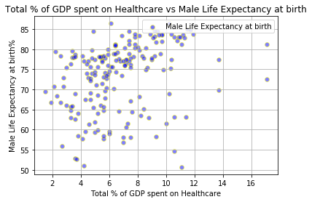

Slide 11
